Slide 1
Intellectual Property
Course ICT Entrepreneurship
Sjaak Brinkkemper

Slide 2
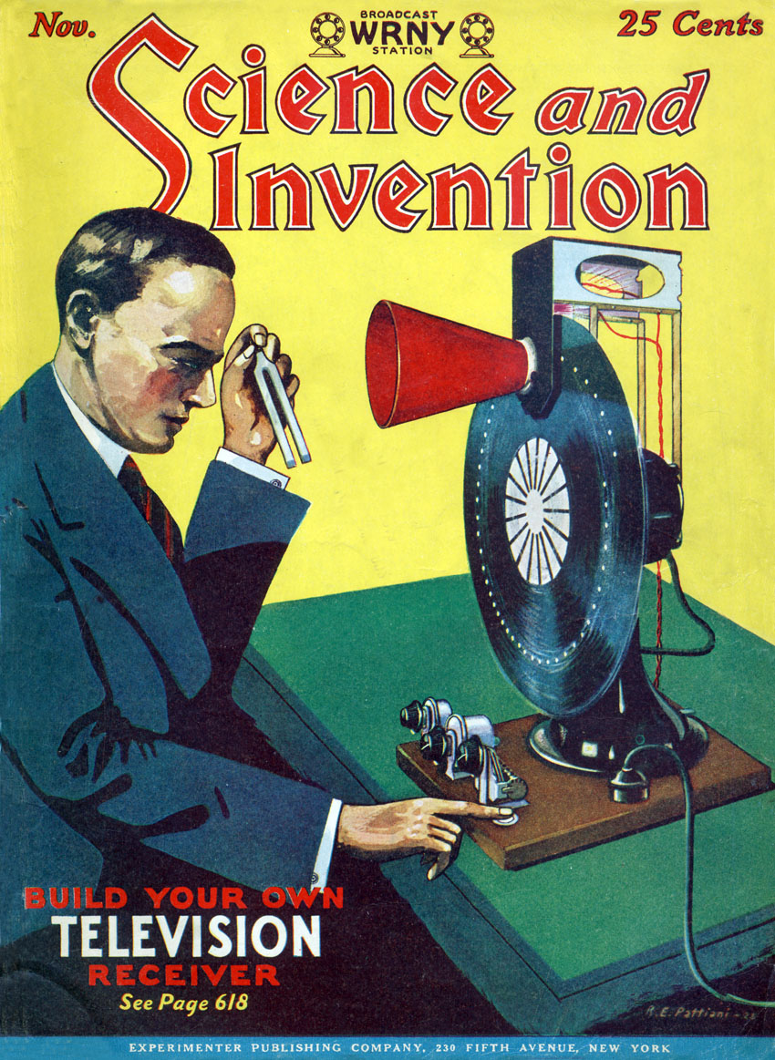
Outline
Forms of Intellectual Property Protection
Copyright
Trade secrets
Trademark
Software Patent
Open Source and relicensing
Recommendations
Notes:
*
‹#›

Slide 3
Intellectual Property
Definition:
Intellectual Property (IP) is any intangible asset that consists of human knowledge and ideas.
Examples are patents, copyrights, trademarks, designs, models, and software.
IP cannot be recognised on a balance sheet when internally generated, since it is very difficult to objectively value intellectual property assets
Different rules apply in the case of software.
They can, however, be included in a balance sheet if acquired, which allows a more accurate valuation for the asset.

Slide 4
Relevant forms of IP
Declaring IP rights yourself
Copyrights
Trade secrets / know how
Trademarks
Patents
Third-party components
Obtaining Rights from others:
Licensing
Cross license

Slide 5
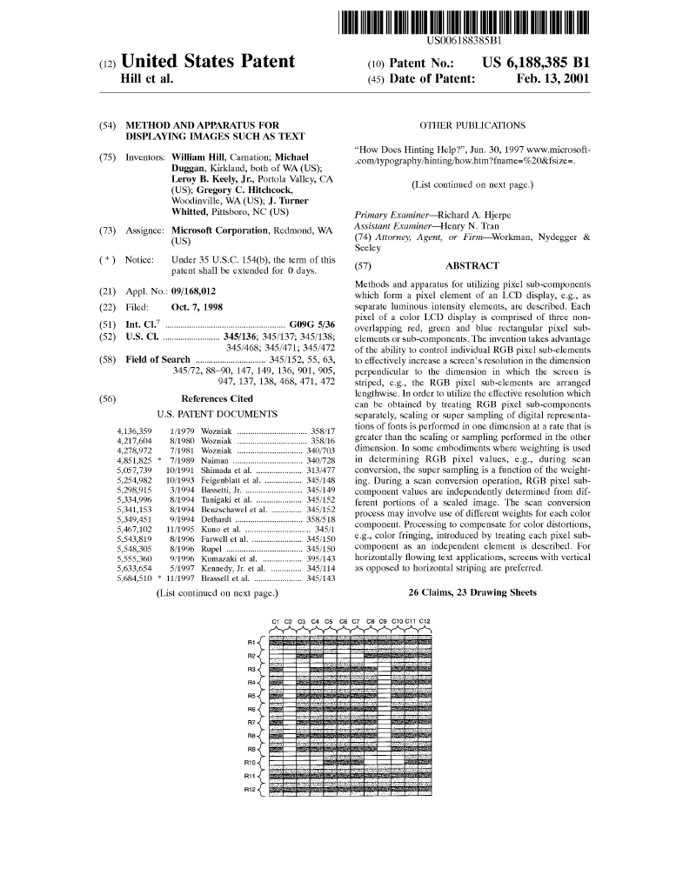
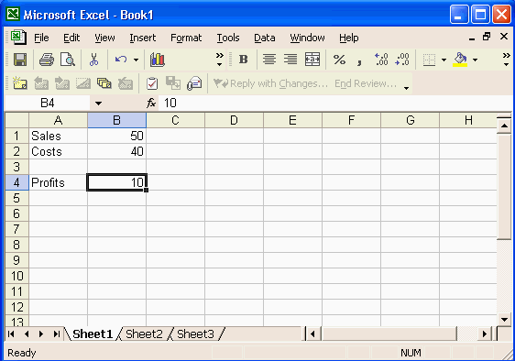
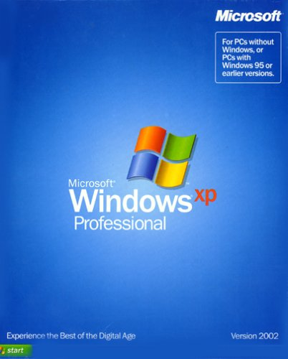
IP flow
‹#›
Source Code
Specification /
Documentation
Functionality
Packaging &
User interface
int main(int, char*)
{
long i, n, x;
cin >> n;
i = 0;
x = 1;
while (i < n) {
x = x * 2;
i = i + 1;
}
count << x;
Source code, objects and routines
Know-how stating and explaining the functionality
Functional behaviour, including file formats and data structures
Pictograms, marks, logo’s
3rd party
components
Copyrights
Patents
Trademarks
Trade Secrets
Notes:
*
‹#›
Cross-license = give one party a licence to use (patented or copyright material) in return for a similar licence.

Slide 6
What are your questions on IP?
Copyrights
Trade secrets / know-how
Trademarks
Patents
Third-party components
Licensing
Cross license
Open source licenses
Put them in the chat.

Slide 7
Copyrights
The copyright is the exclusive right of the creator of a work of art or science, or of its right obtainers, to publish and distribute the work, except for legal restrictions.
Exist the moment an idea is reduced to tangible form:
creating a design
writing source code
making a website
etc.
Usually owned by the employer by means of the employment contract
In NL no formalities are needed: a copyright comes into existence by making the work (until 70 years after the death of the author).
In other countries it may be necessary:
Proper designation on anything textual, visual, or audio: Copyright © Oddity B.V. 2018
Bring documents to tax office or notary for timestamp (4€/page)

Slide 8
Trade secrets / know how
What about
reverse engineering?
Intended to constrain competition.
A trade secret is information that:
is not generally known to the public;
confers some sort of economic benefit on its holder;
is the subject of reasonable efforts to maintain its secrecy.
The know how is crucial knowledge related to a business
Often intangible in form; “the way we do things”
Examples: product or services, processes, customers, organisation, state of affairs
You can protect it with non disclosure agreements (NDA)
Notes:
*
‹#›

Slide 9


Trademarks
A trademark is the exclusive right to utilize an expression of art or science to identify a good
The purpose of a trademark is to distinguish the own character and to establish a reputation.
A trademark can be:
Name
Shape
Drawing
Print
Stamp
Fragrance
Colour
Slogan: Sense and simplicity
Proper designation: McDonalds® or ™

Slide 10
Trademarks - Slogan
Examples of slogans:
Innovation and You (Philips)
Because You’re Worth It. (L’Oreal)
What’s In Your Wallet? (Capital One)
Shave Time. Shave Money. (Dollar Shave Club)
They’re G-R-R-REAT! (Kellogg’s Frosted Flakes)
1. A short and simple phrase
2. Product - company - customer consistency
3. Focus on what makes you different
4. Make it endless

Slide 11
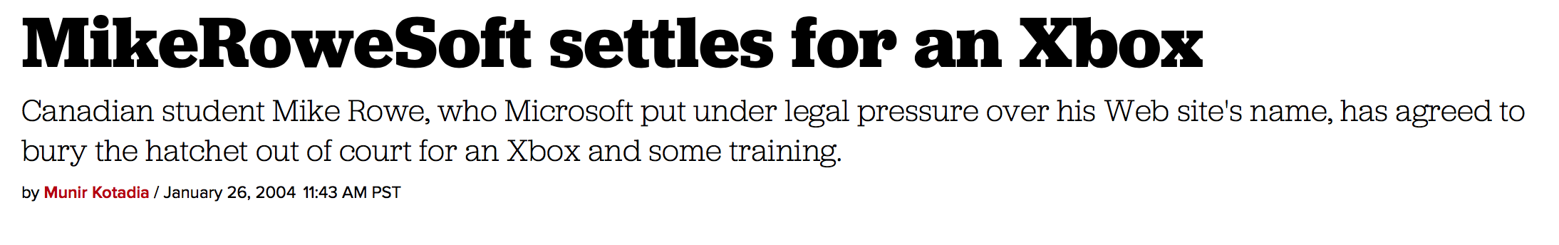
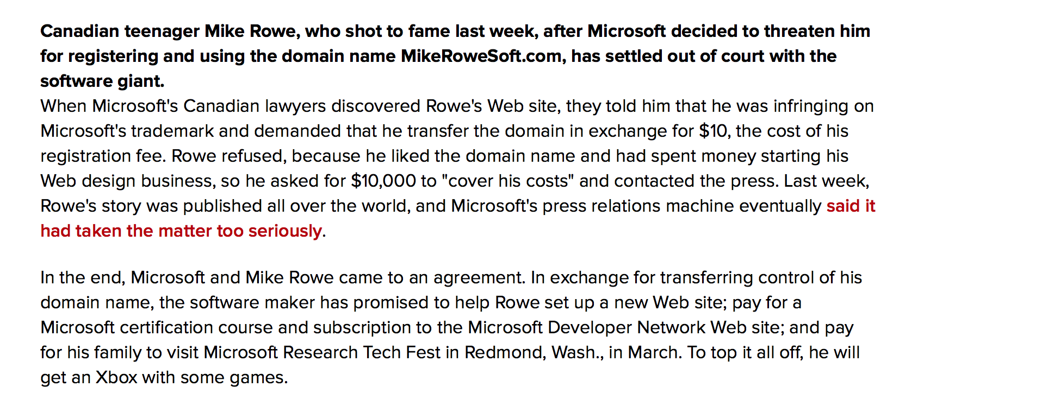

Slide 12
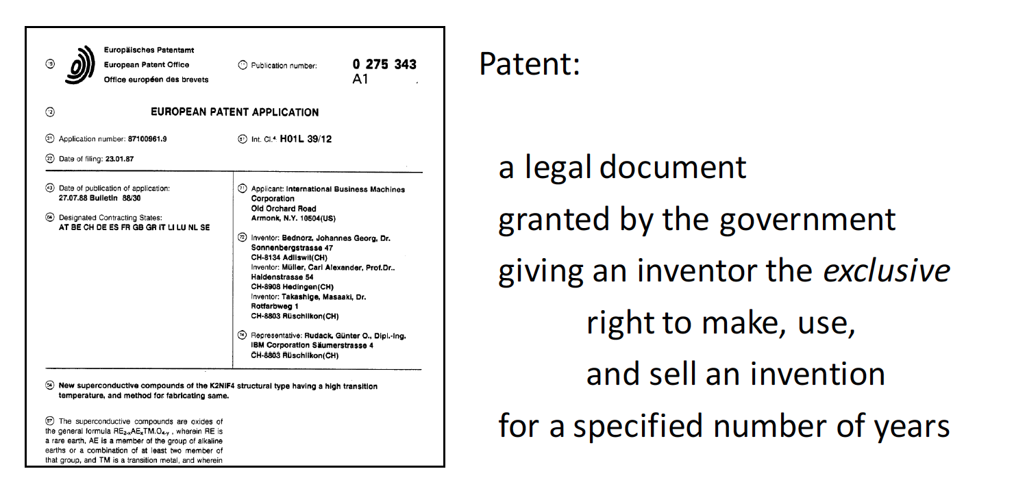
Patent
Used by many technology companies to protect intellectual capital
Design can be patented; no need for sellable product
Owned by inventor or employer
Employee is recognised and rewarded as inventor
20
Notes:
*
‹#›

Slide 13
Patent
What can be patented?
“New”
New at the date of filing the patent application
New if it does not form part of the "state of the art”
"State of the art" means everything made available to the public before the filing date
There must have been no public disclosure of an invention before the filing date of the patent application
Not sold! Can be in beta-test
“Inventive”
Significant improvement to existing technology
Not obvious for ‘a person skilled in the art’
Societal or industrially applicable
Useful: concrete and tangible

Slide 14
Patent
What cannot be patented in the European Union?
Discoveries, scientific theories and mathematical methods
Aesthetic creations
Schemes, rules and methods for playing games or doing business
Presentations of information
Inventions whose commercial exploitation would be contrary to "ordre public" or morality
Plant or animal varieties or essentially biological processes for the production of plants or animals
Methods for treatment of the human or animal body by surgery or therapy and diagnostic methods practised on the human or animal body
…and software?

Slide 15
Patenting software un EU
Program for a computer "as such" is excluded from patentability, but…
Not excluded from patentability if, when running on a computer, it causes a further "technical effect" going beyond the "normal" physical interaction between the program (software) and the computer (hardware)
Programs for computers are therefore not automatically excluded from patentability
So: relate to hardware like a computer, tablet, mobile.

Slide 16
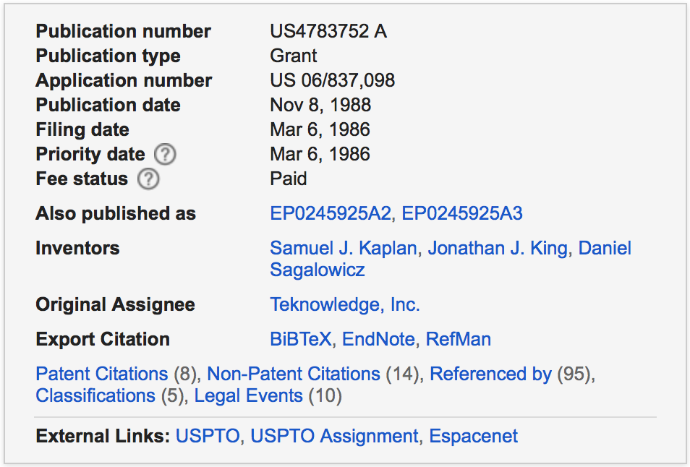
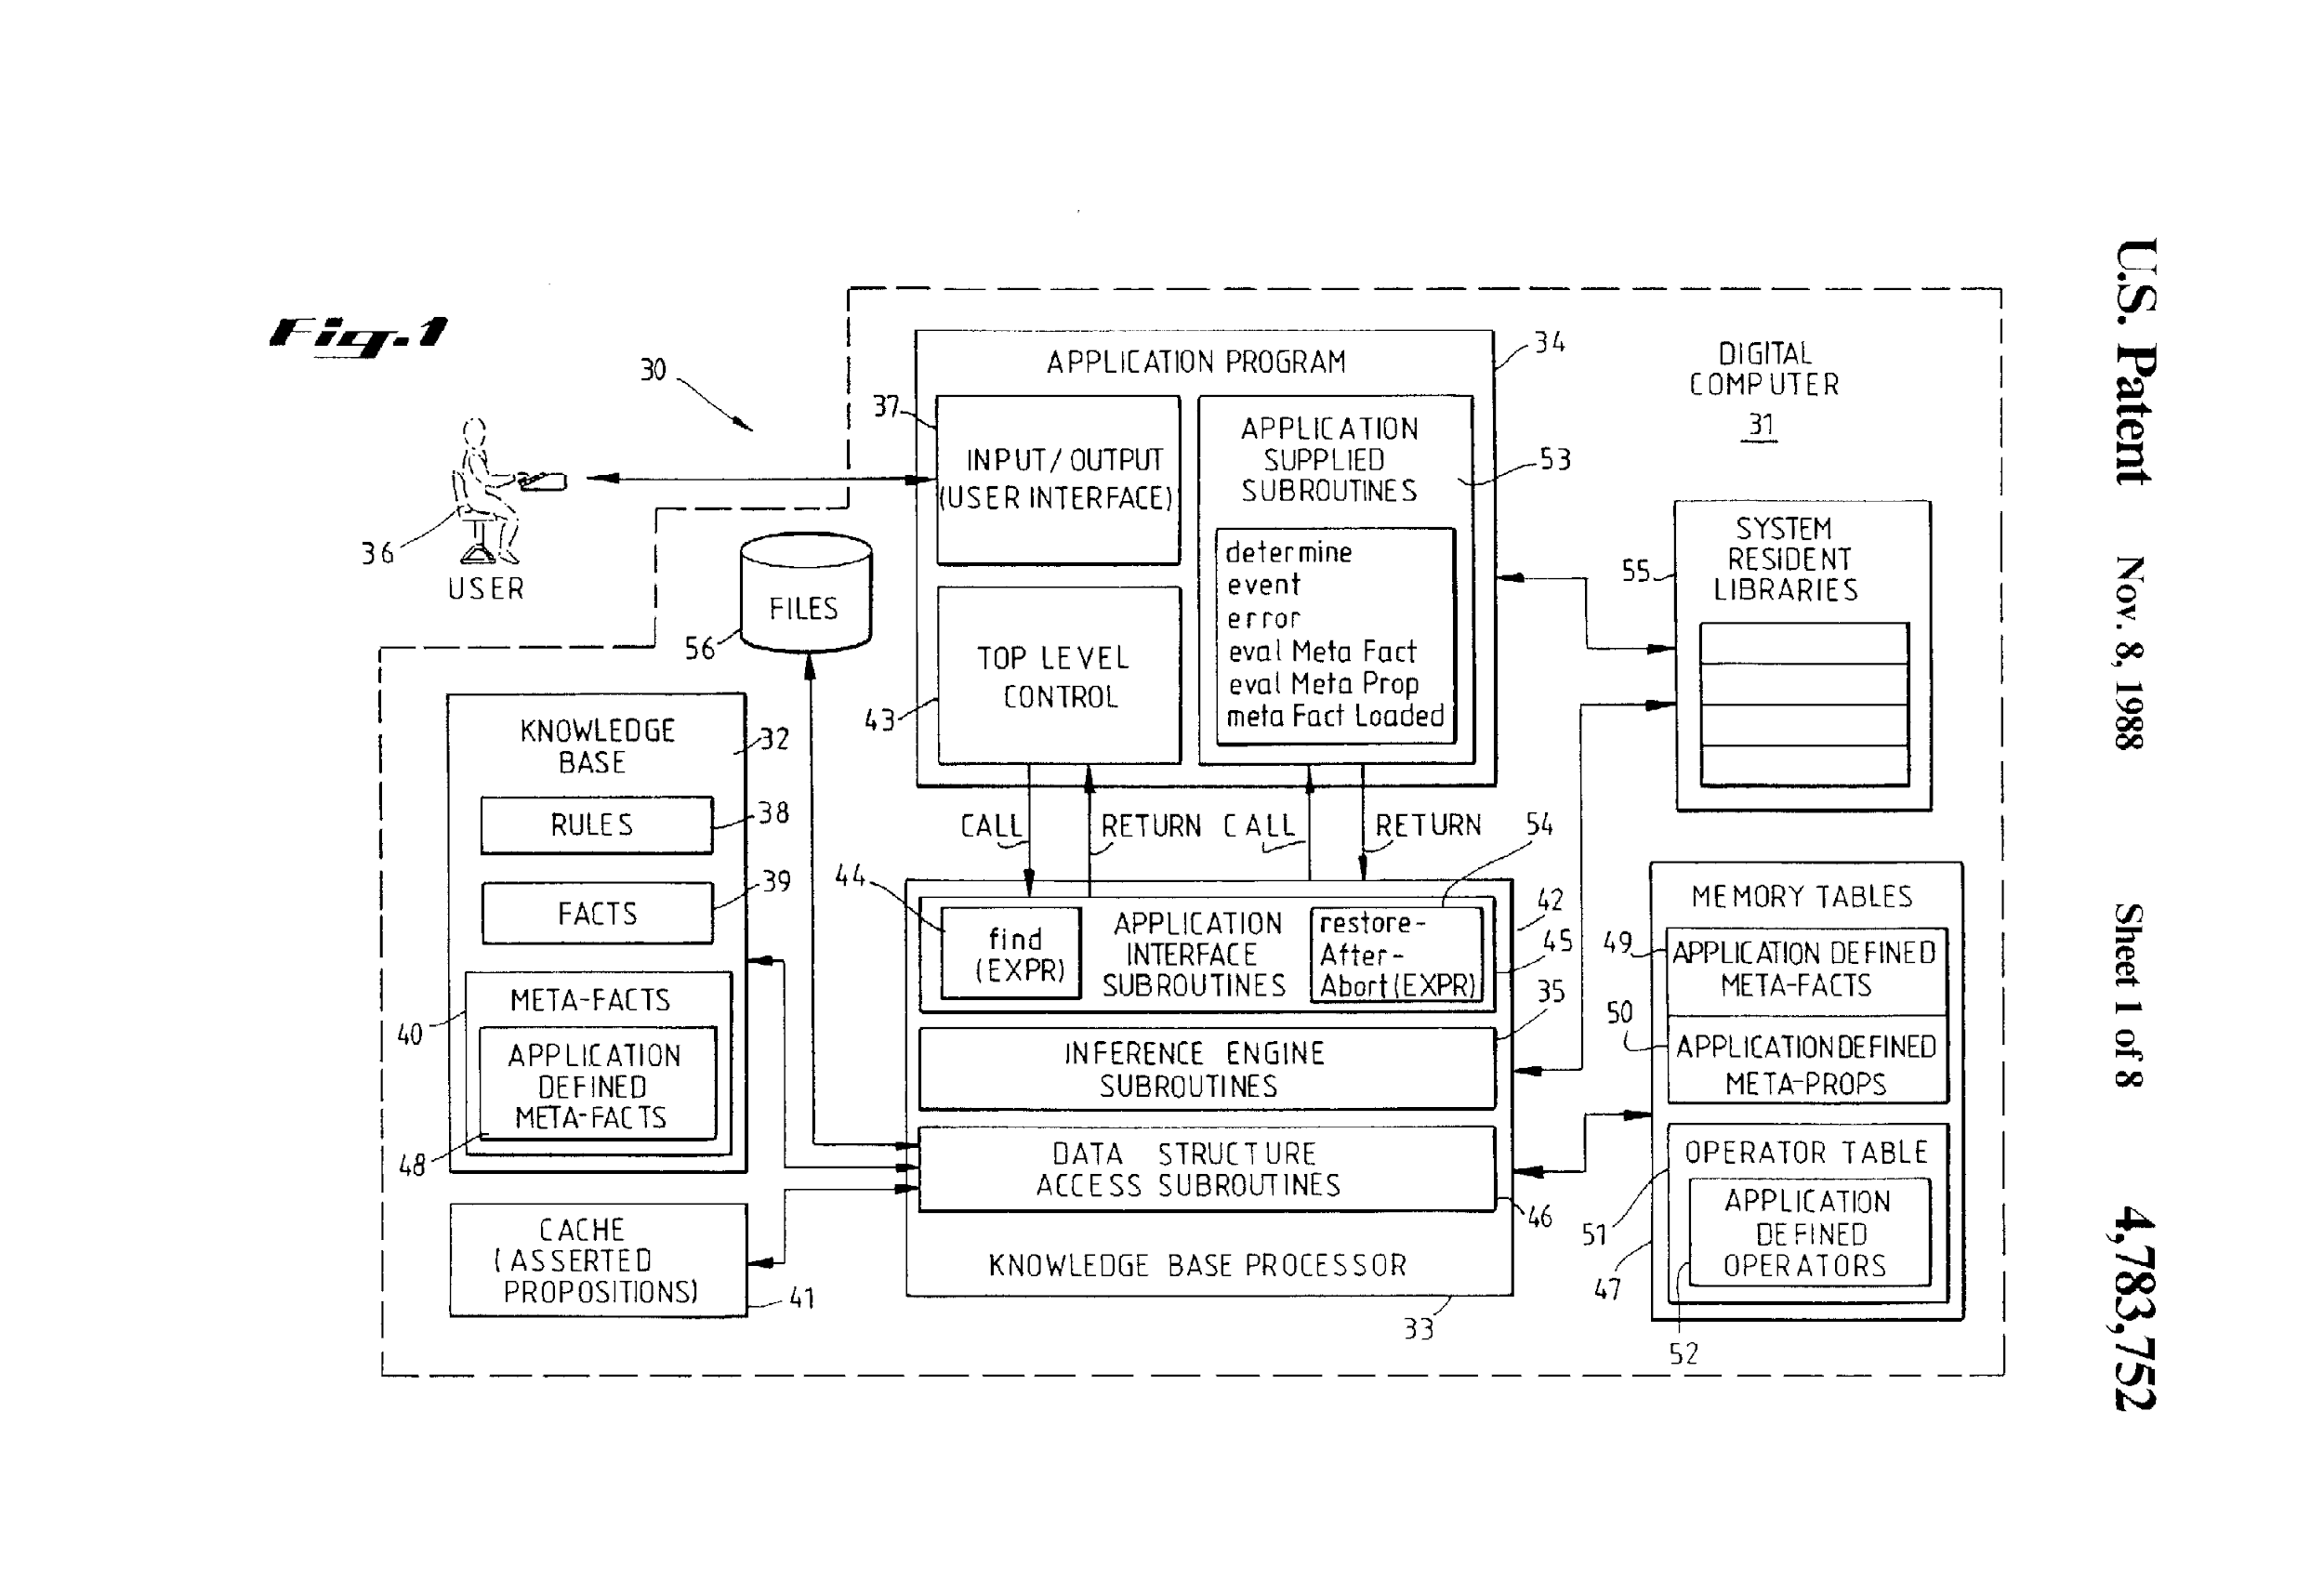
Patent example
Knowledge based processor for application programs using conventional data processing capabilities
US 4783752 A
Patent application document
238 pages
8 figures
41 claims
See httpshttps://www.google.com/patents/https://www.google.com/patents/US4783752

Slide 17
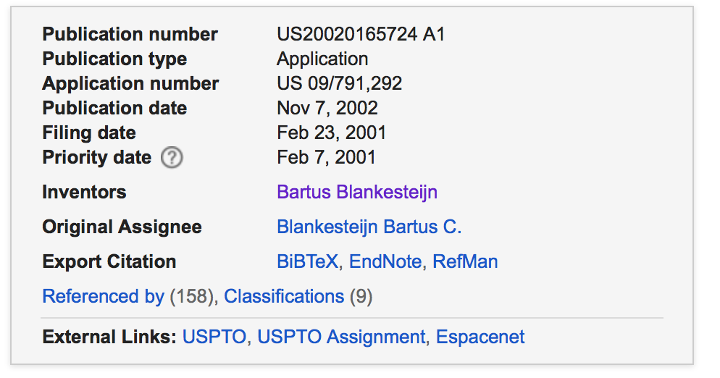
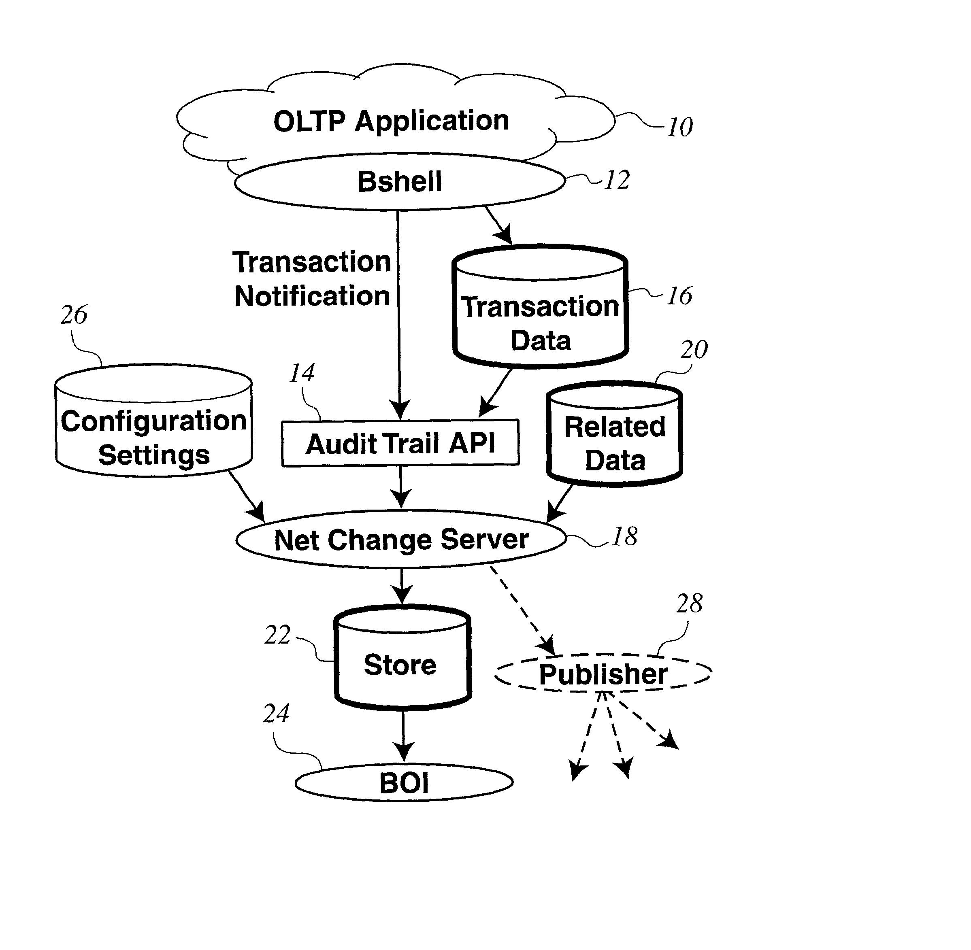
Patent example
Method and system for propagating data changes through data objects
US 20020165724 A1
Patent application document
95 pages
21 figures
76 claims
See https://www.google.com/patents/https://www.google.com/patents/US20020165724

Slide 18
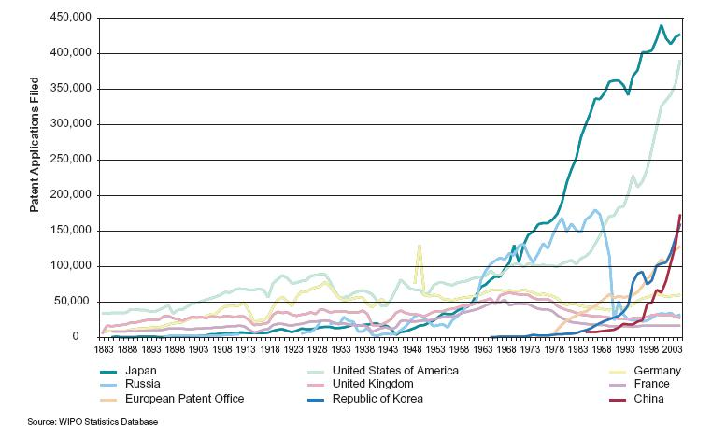
Growth in patents

Slide 19
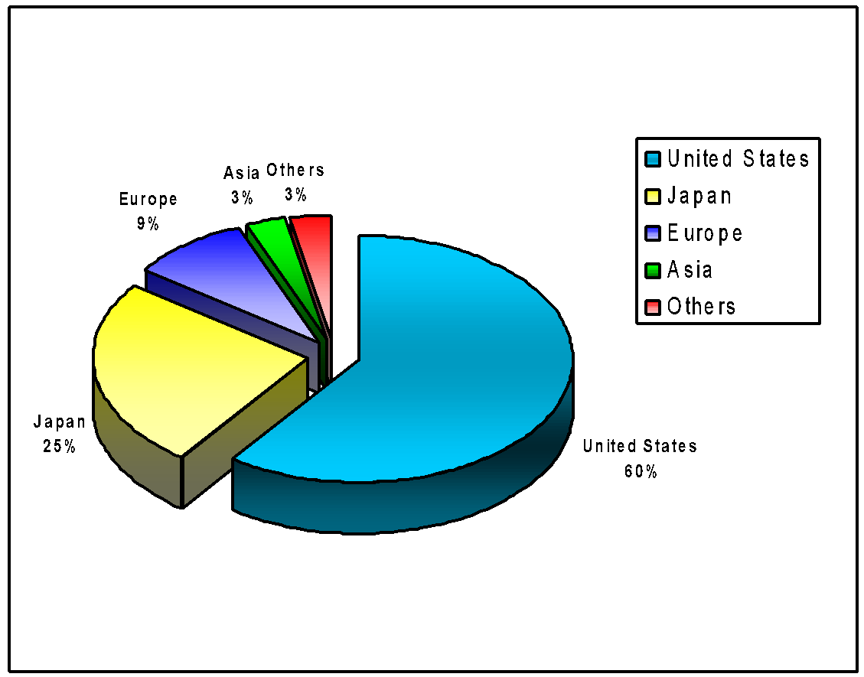
Regional Breakup of Patents
Source: Internet Patent News Service

Slide 20
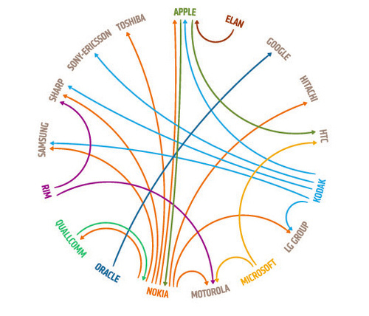
Lawsuits in the mobile business

Slide 21
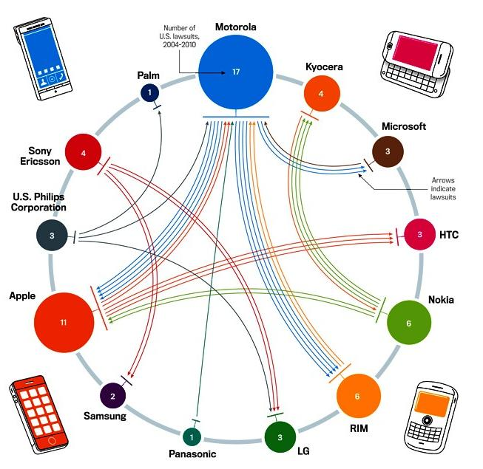
Lawsuits in the mobile business

Slide 22

Patent Application
National Patent Offices
Benelux Office of Intellectual Property (BOIP); part of Ministry of Economic Affairs
USPTO (US Patent & Trademark Office)
EPO (European Patent Organization)
WIPO (World Intellectual Property Organization)
Documentation: Description, Figures and Claims
Cost
Development costs
Legal costs: patent counsel for documenting, prosecution
Filing costs: application, issuing, maintenance
Total: approx. 20.000 €
3 – 5 years before granting; patent pending
Documentation becomes public See patents.google.com

Slide 23
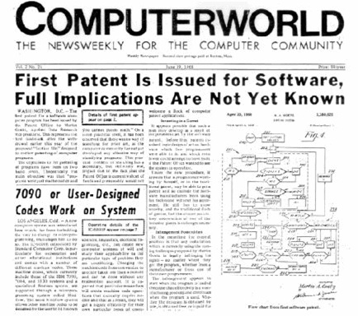
Some history of Software Patents
No software patents until 1981: patent for rubber curing software system
1994: Stac Electronics vs. Microsoft: DoubleSpace disk compression program
MS to pay 130M $
MS aggressively set up patent portfolio
Most US patents: IBM, Microsoft, Apple, Sun
Patent disputes
Shopping cart
One Click patent of Amazon
Reverse Auction of Priceline
Teknowledge vs SAP
Patent trolls

Slide 24
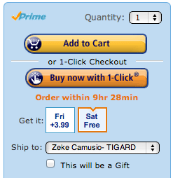

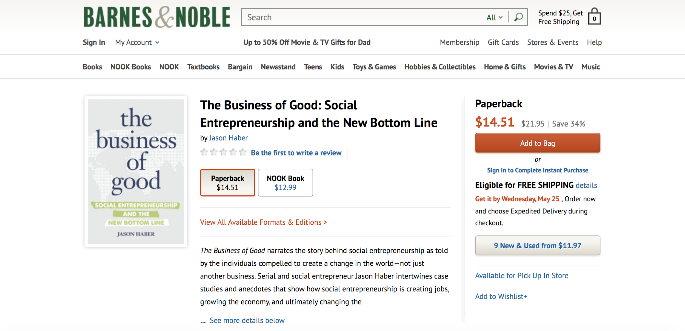
Some history of Software Patents

Slide 25
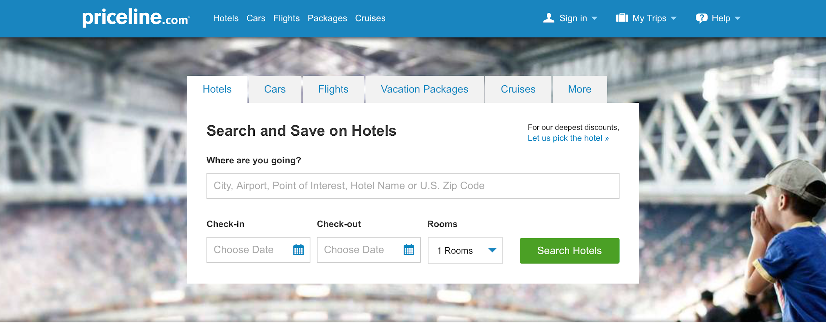
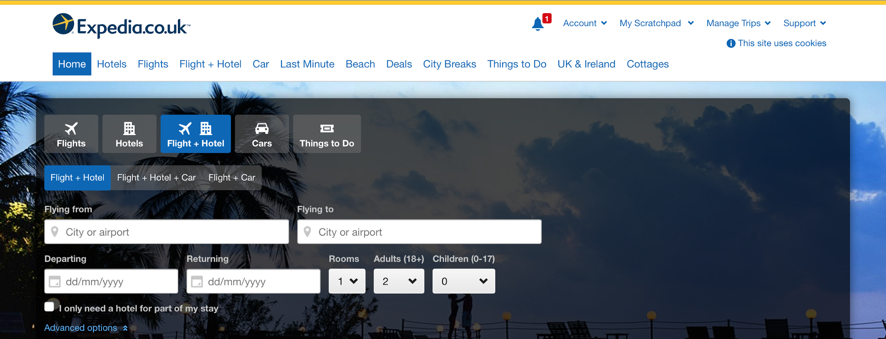
Some history of Software Patents

Slide 26
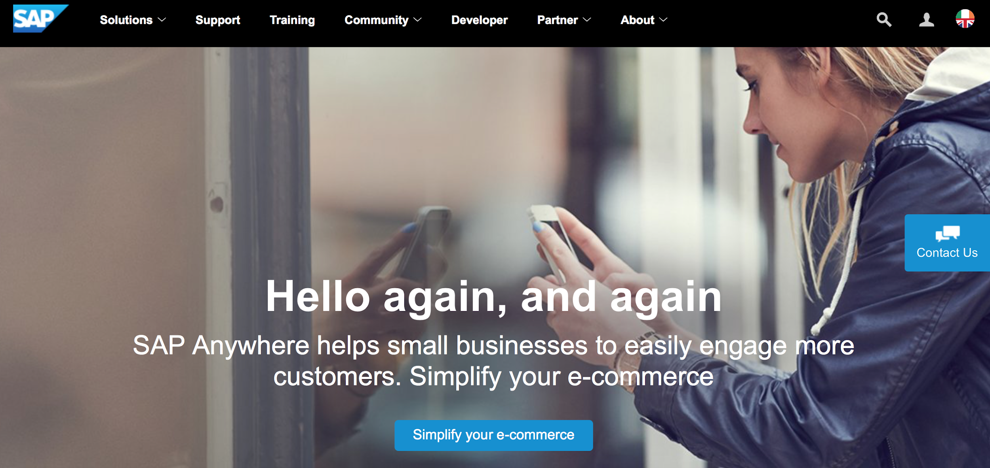

Some history of Software Patents

Slide 27
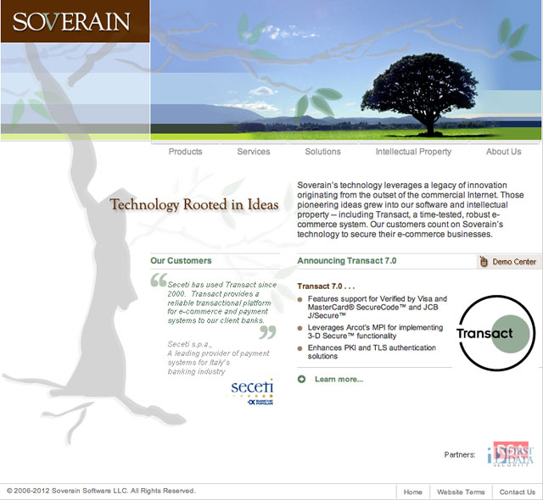
Some history of Software Patents

Slide 28
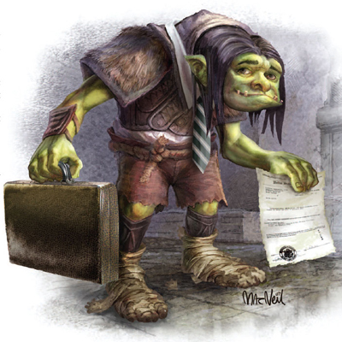
Patent Troll
Patent troll is a pejorative term used for a person or company that enforces its patents against one or more alleged infringers in a manner considered by the target or observers as unduly aggressive or opportunistic, often with no intention to manufacture or market the patented invention.

Slide 29
Effects of Software Patents
Royalties
Licensing revenue
Cross licensing
Entry barriers
Prohibit others to copy functionality
Competitive advantage
Marketing value
Slow development of competitors
Stop sale of infringing products
Increased capitalisation of company

Slide 30
Patents of ERP companies
Patents per Competitor
12
10
# of Patents
8
6
4
2
0
Baan
i2Tech.
PeopleSoft
J.D.Edwards
S.A.P.
Source: USPTO

Slide 31
Software Patents at Baan
Baan owns 6 patents, including in the areas of database synchronization and interactive configuration systems
All were acquired in the course of acquisition of Aurum/Beologic
Baan has 13 patents jointly owned with Sun on Javasoft project (bootstrapping with Sun)
Baan has 1 patent pending for Net Change Server
There was a “formal” patent protection program within Baan to ensure on-going review of and filing for patentable inventions
Notes:
*
‹#›

Slide 32
Baan R&D policy on patenting
Baan has a patent portfolio
Patenting in US only: launching market
Patent application requires positive ROI expectations
Central patent program management
Cooperation with Intellectual Property office
Expected 2 – 4 patents per year
Notes:
*
‹#›
For some time, attorneys and developers converted software into hard-wired circuits to facilitate patenting.
Stac Electronics vs. Microsoft: Double stacker

Slide 33

Who is involved in patenting
Inventor(s): Architect, Engineer, Consultant
Patent Program Manager: for first scan, ROI of patent, decides on acceptance for patent process, coaches inventors through process
Product Manager: for novelty check and prior art
Development Manager: testimony of inventor’s work
IP office: arrangements with patent counsel
External Patent Counsel: drafting of patent documents
USPTO: office to file
Finance: pay invoices

Slide 34

Process for patenting
Inventors design new product features: documentation in design
Contact Patent Program Manager for scan of patentability
If accepted: fill out invention form
IP office to hire external patent counsel
Patent counsel writes patent application
Inventor reviews draft patent application
IP office files patent application at USPTO
USPTO reviews patent application; questions to inventor
USPTO to grant patent
Inventors receive bonus and award
Notes:
*
‹#›

Slide 35

Benefits for the inventor(s)
Professional recognition
Invention on CV
Small reward at filing
Large reward at granting
Shared in case of a team effort!

Slide 36
Third-party components
‹#›
Included in the product are:
Third party software
Code snippets
Header files
Fonts, images, icons, photo’s, colours
Standards
Development tooling
Documentation

Slide 37
Their IP
‹#›
Non-disclosure agreements with partners
Reference to copyright and trademark best-effort
Clear usage of © ™ ®
About box in software
Notes:
*
‹#›

Slide 38
Their patents
‹#›
TomTom vs. Garmin
Still very unclear, also for lawyers
Cash cow for lawyers
Calculated risk
Mainly US at the moment

Slide 39
Their product: software licences
‹#›
Closed source licenses
License compatibility
Problems
Weird licenses
License violations
Code snippets
Out-of-date contracts
Prerequisites on CD
Support and Services make own distribution packages
Open Source licenses...
Notes:
*
‹#›

Slide 40
Open Source licences
‹#›
What are Open Source licences?
Licences approved by OSI, see www.opensource.org
Legally binding
Large diversity: reciprocal, copyleft, creative commons, relicensable
Other licenses
Free software, see www.gnu.org
Freeware, cardware, giftware, etc.
Most are legally unclear
Does your product contain Open Source components?
Notes:
*
‹#›

Slide 41
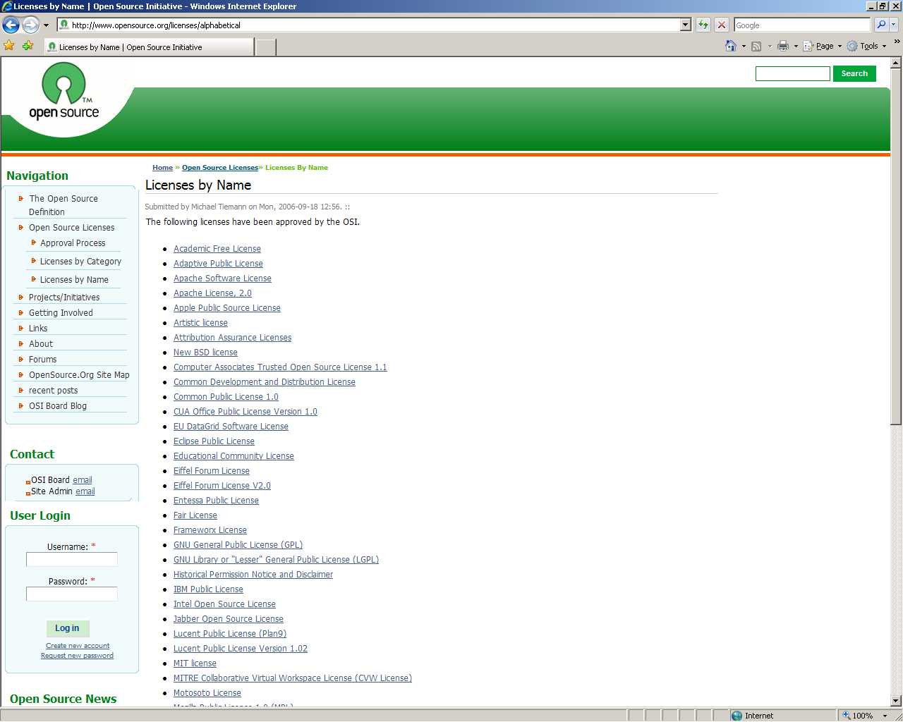
‹#›
Intellectual Property | Amsterdam
Notes:
*
‹#›

Slide 42
Relicensing
‹#›
Suppose we include software with open source license
We replace their license by our license
We include these in the product, and then we sell.
Is this allowed?
Sometimes it is (under conditions)
And sometimes it isn’t
Notes:
*
‹#›

Slide 43
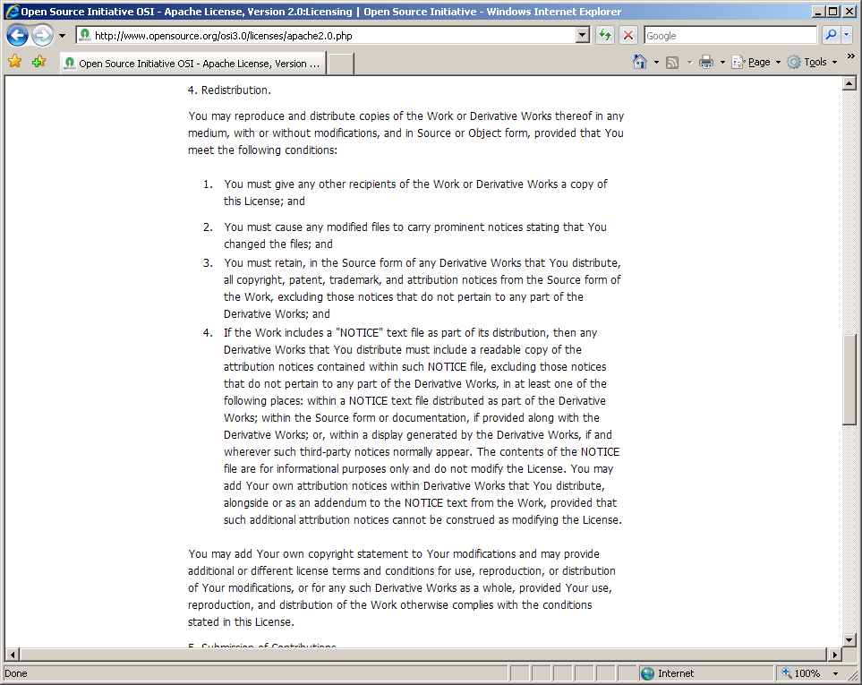

Licensies in detail: Apache
‹#›
GPL
Intellectual Property | Amsterdam
Notes:
*
‹#›

Slide 44
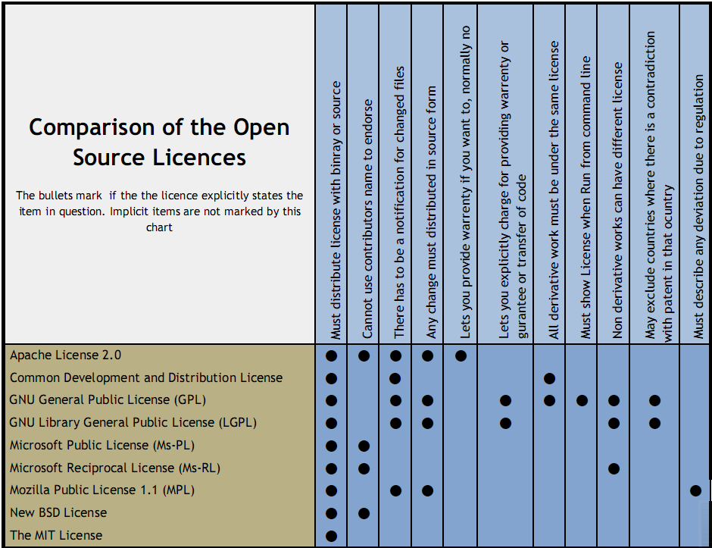

Slide 45
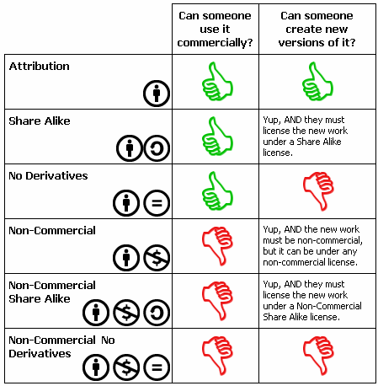
Creative commons
Non-software licenses
See http://creativecommons.org/licenses

Slide 46

Creative commons
Attribution: Give credits
Non-commercial
Derivative works too
Share alike

Slide 47
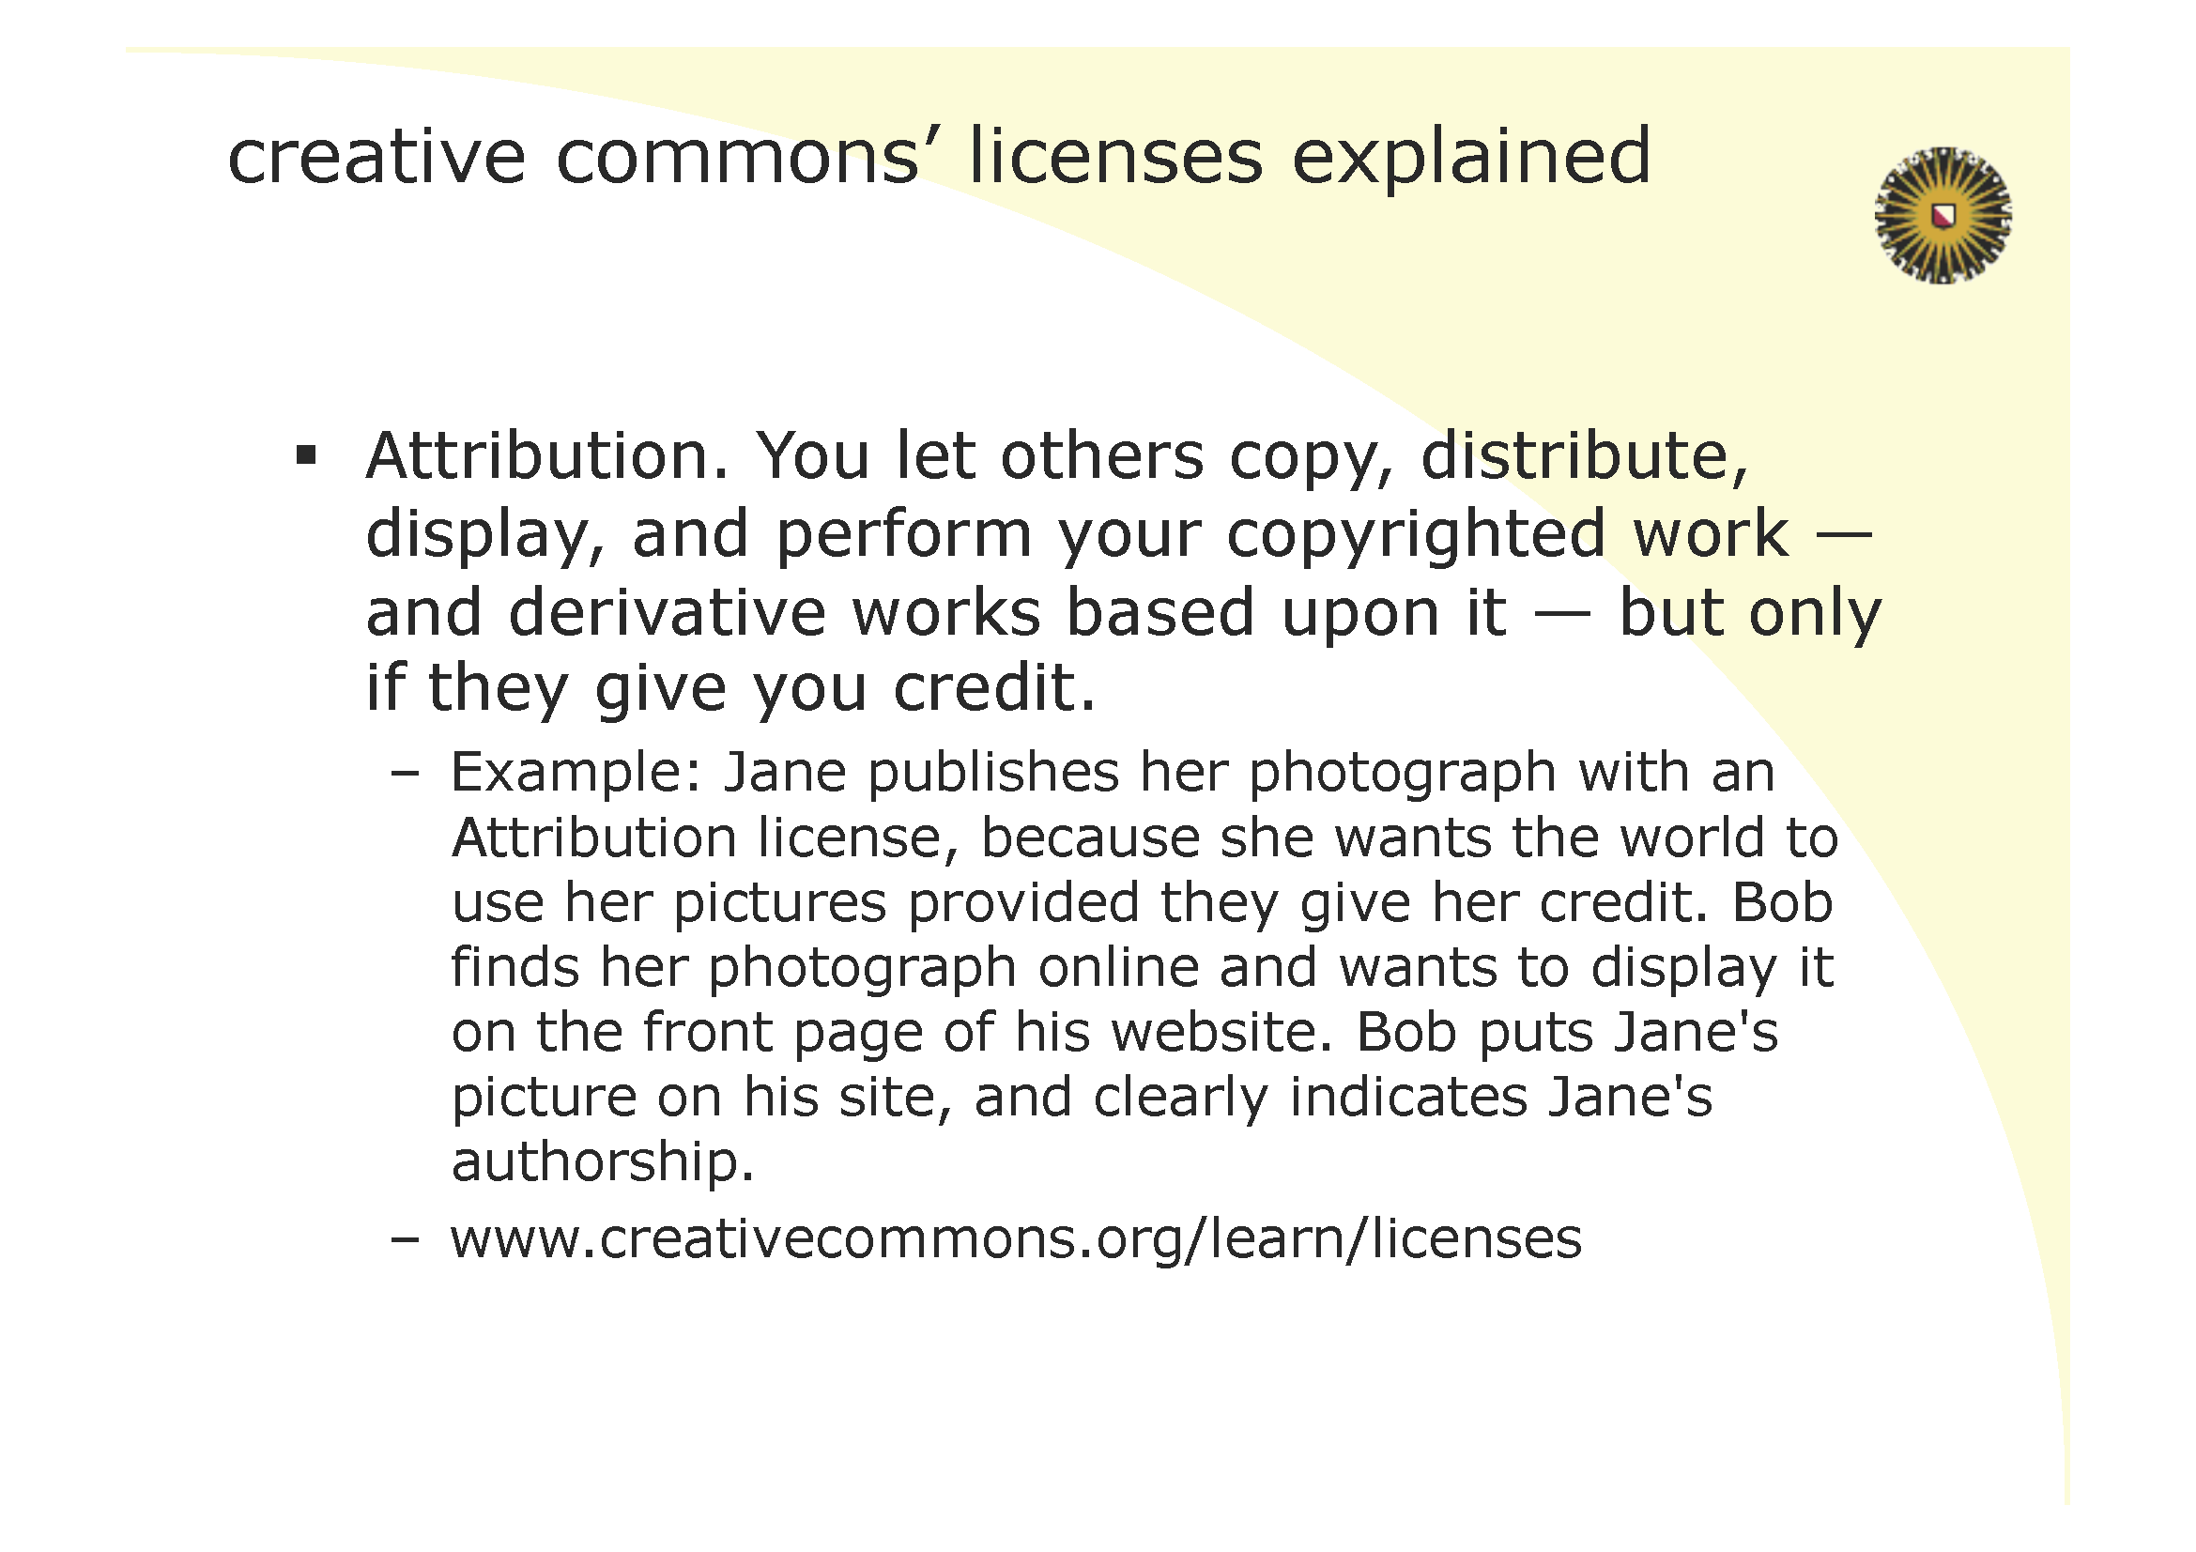

Slide 48
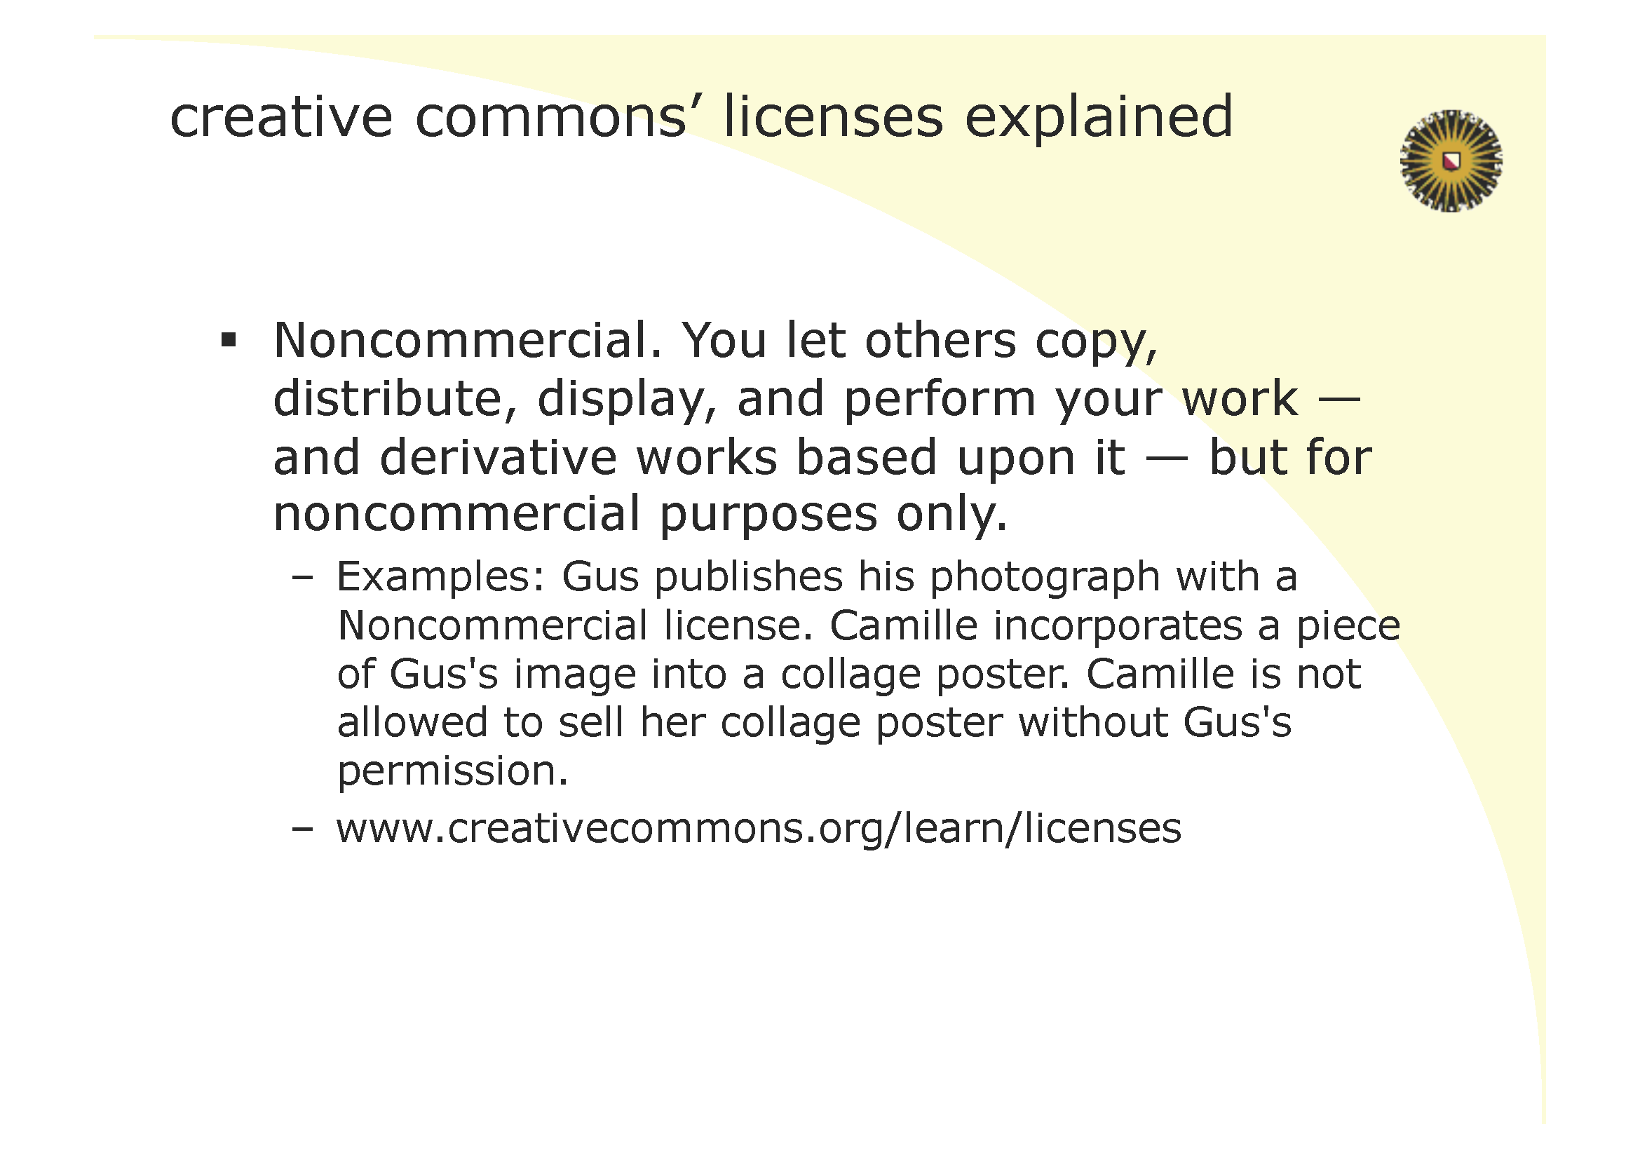

Slide 49
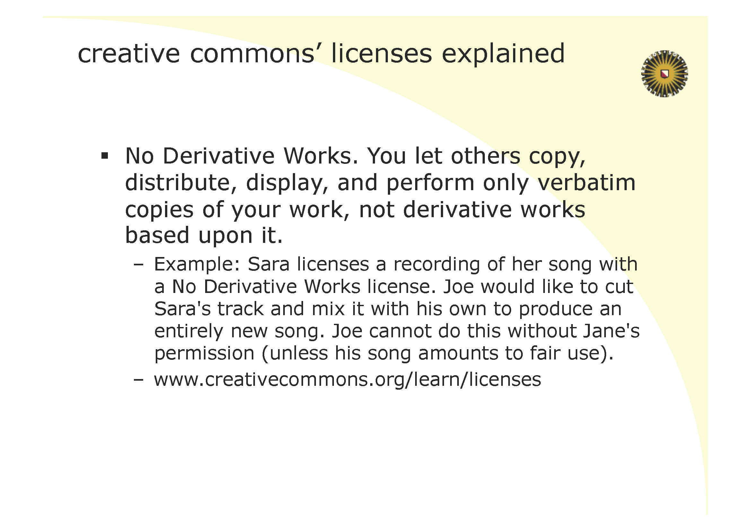

Slide 50
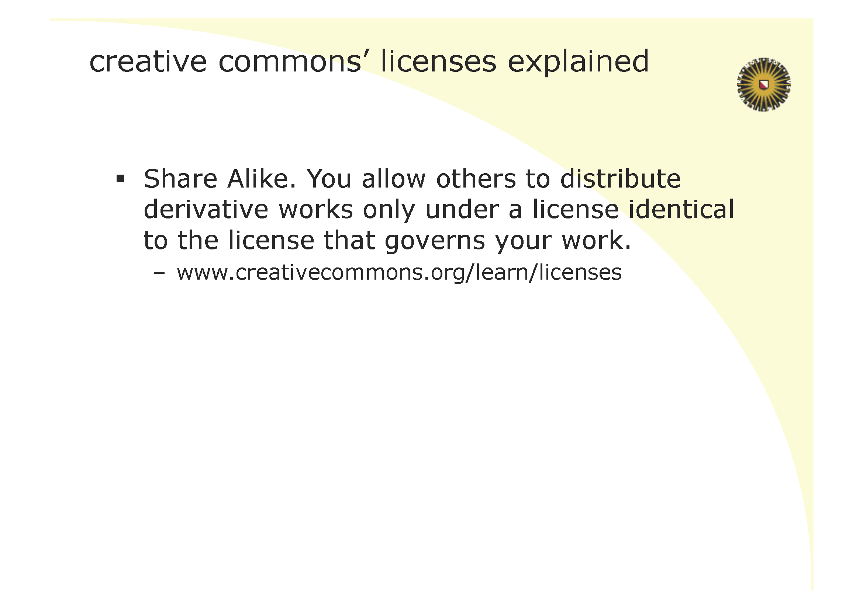

Slide 51
Open source licenses: wrap-up
‹#›
Each component requires specific attention
Modification, reciprocal, copyleft, patent infringments, relicensing
GPL is never allowed in proprietary software, LGPL is allowed unmodified, etc.
Establish a policy, and communicate to developers
Sometimes administrative consequences
Maintain a list of incorporated third party components
Very problematic
Many violations around
Impact on product, documentation and license agreements
Establish policy with your partners
Notes:
*
‹#›

Slide 52
Recommendations
Have great ideas in excellent products!
Monitor patents in patent databases on the web: e.g. www.uspto.gov
Excellent search facilities in www.google.com/patents
Prepare a software design as an input for patent draft
Be extremely cautious with external communications (NDA!)… but use common sense.
Maintain 3rd party IPR administration
Notes:
*
‹#›

Slide 53
Discussion
Status of EU regulations
Any inventors around?
Questions?
How about Open Source?
Notes:
*
‹#›

